Slide 1
Determining "high-significance" nodes in a network of legal documents indicating one or more key obstacles for law makers implementing new laws during a pandemic.
Influenced by the corona pandemic, Danish lawmakers made amendments to existing laws and created new laws.
By evaluating common links between all new laws containing "pandemic" keywords we seek to establish the one most relevant document for the creation of future laws.
Law documents matching the keywords and search criteria are referenced as primary documents
INFO
source: www.retsinformation.dk​
Search interval [2019:2023]​
Status: ratified​
Keywords: corona, covid, virus, pandemi​
Documents as nodes
Secondary affected documents form edges
Group 6 – 02467 Social Informatik

Slide 2
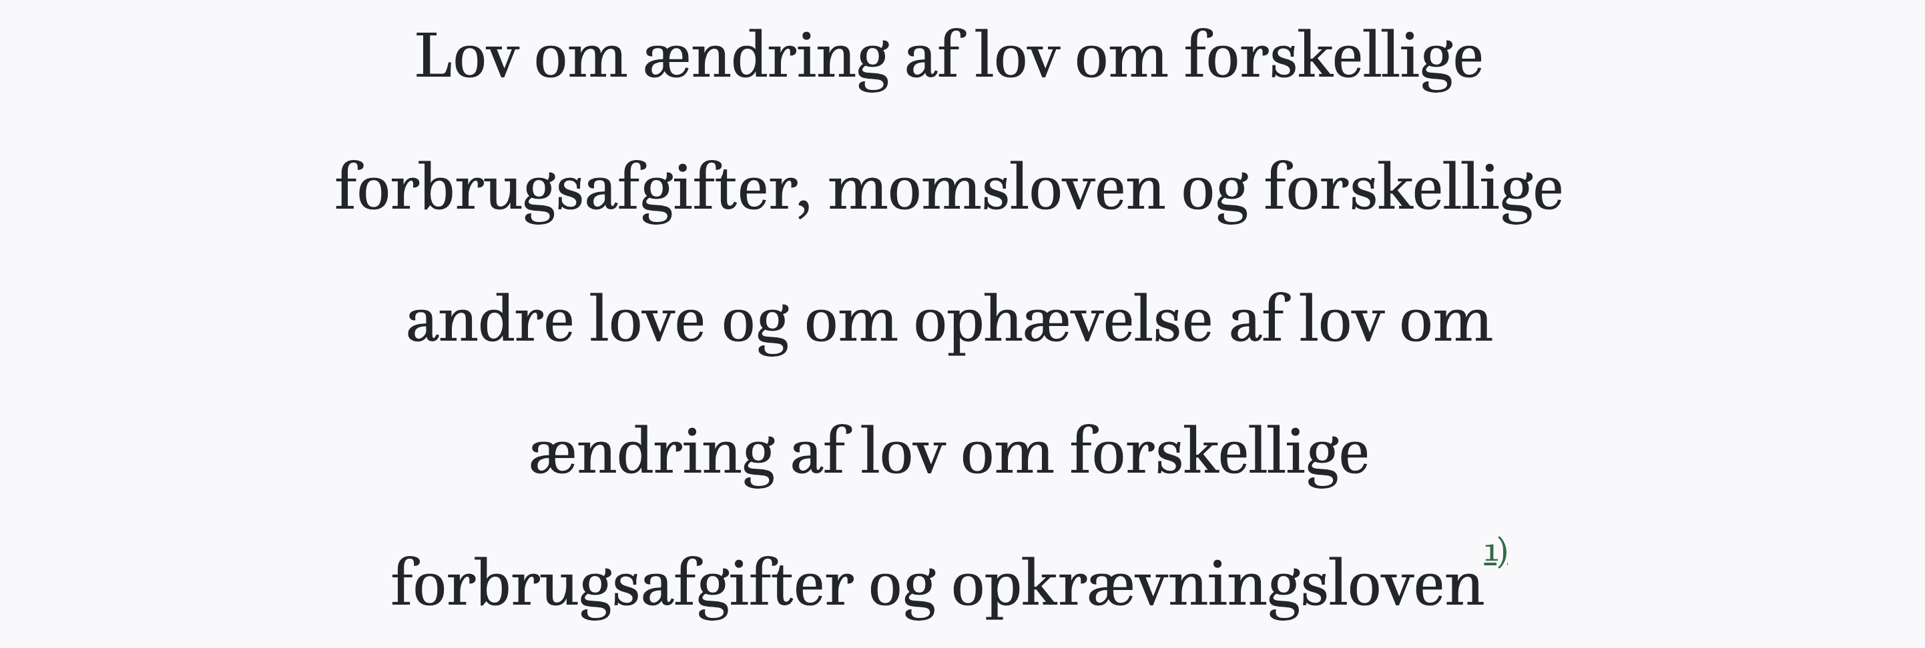
Accessible and incomprehensible
Although highly accessible, the Danish law may not be easily understood by everyone
Subjecting the documents to impartial and unbiased computer algorithms we seek to establish a logical chain of links and establish significant areas of importance in the Danish body of law
Actual danish giberish language example:

Slide 3
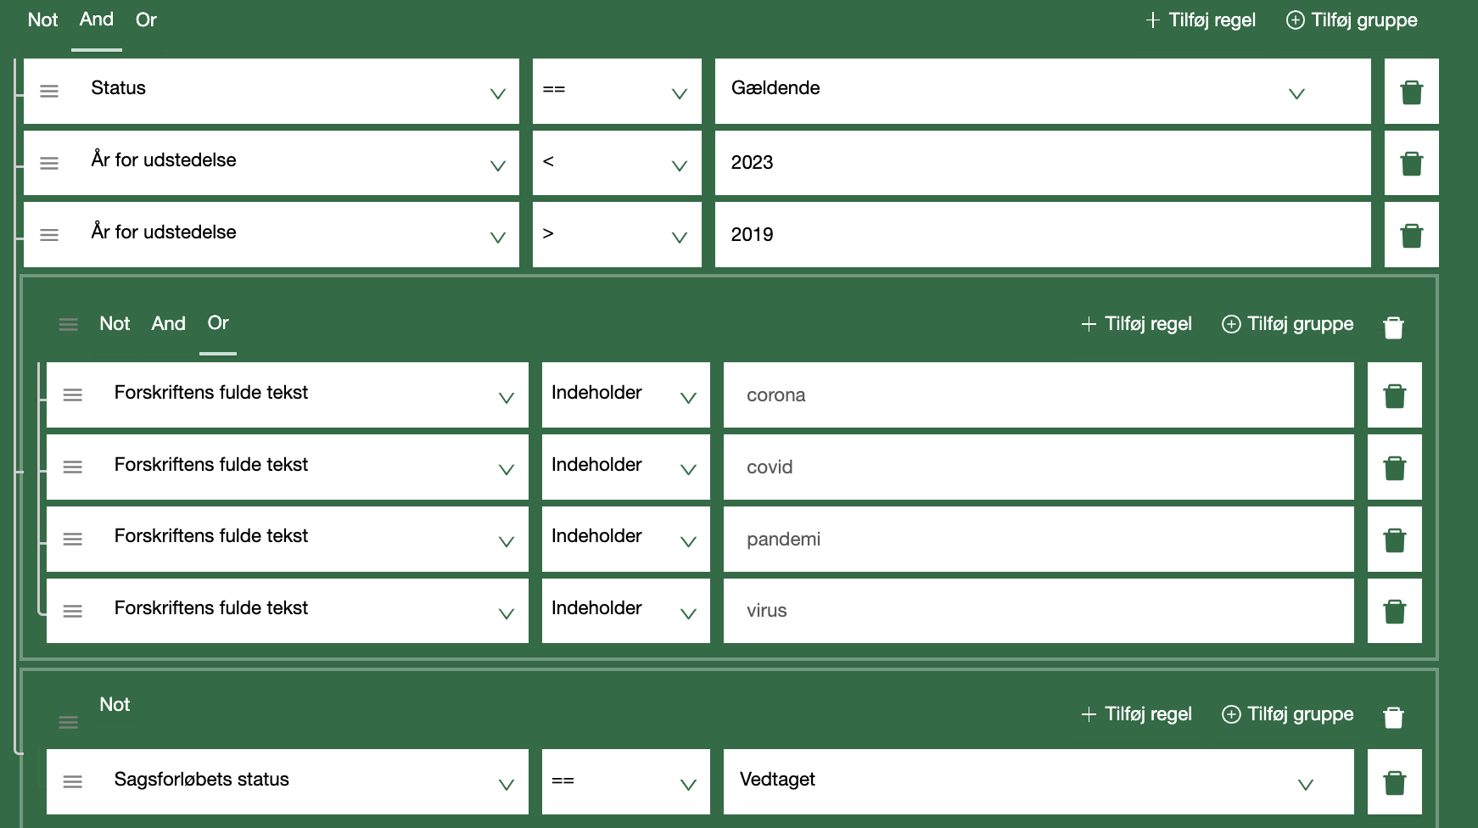
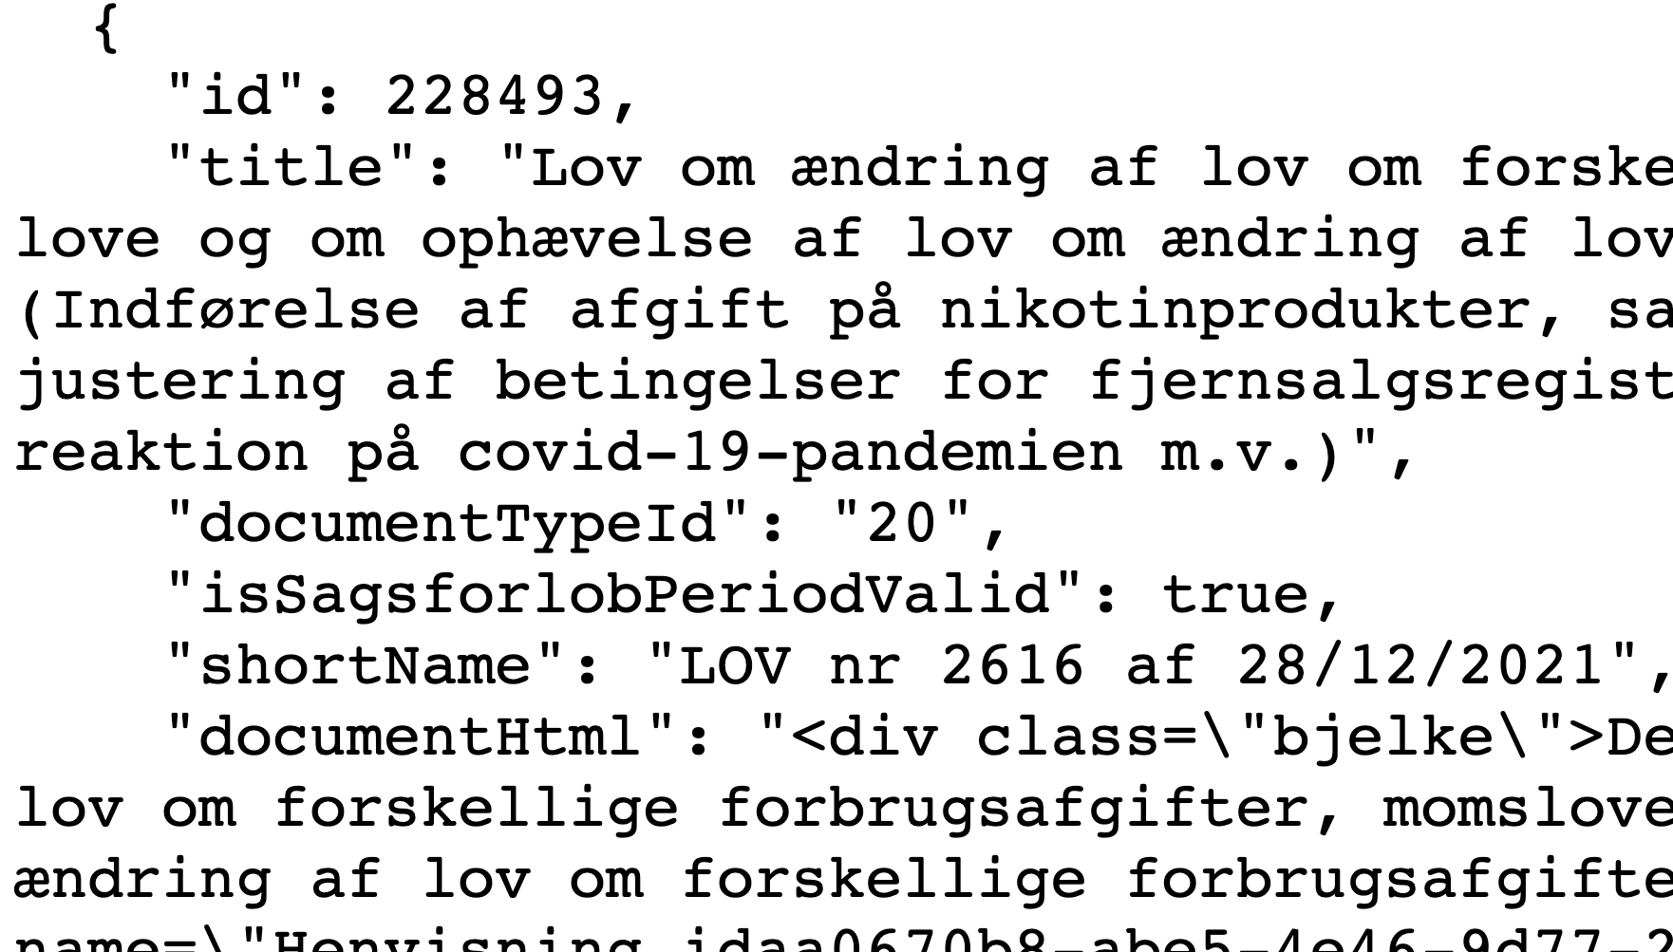
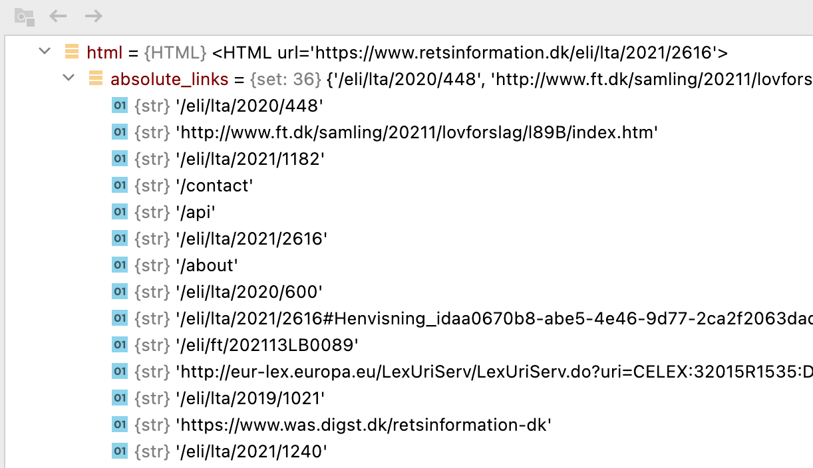
Dataset and API requesting the API requests
1
Preliminary search for primary documents were made using "extreme search" function (1) available at the source website: www.retsinformation.dk
Attributes and text collected using request (2) and secondary documents (edges) found using javascript rendering with requests_html (3)
2
3

Slide 4
Goal & the implementation plan
Define scope of documents and fetch data
343 Primary/initial nodes based on search criteria
Identify Secondary nodes (nodes affected by Primary nodes)
2173 edges in total
Define the network with documents as nodes and references as edges
Identify significant nodes by:
Visualizing the network
Analyze and condition to test "High significance" hypothesis
Tokenize, clean the law texts and generate Wordclouds
Using the Wordclouds based on TF-IDF to understand the contextual association between "high significance" nodes and their neighbours

Slide 5
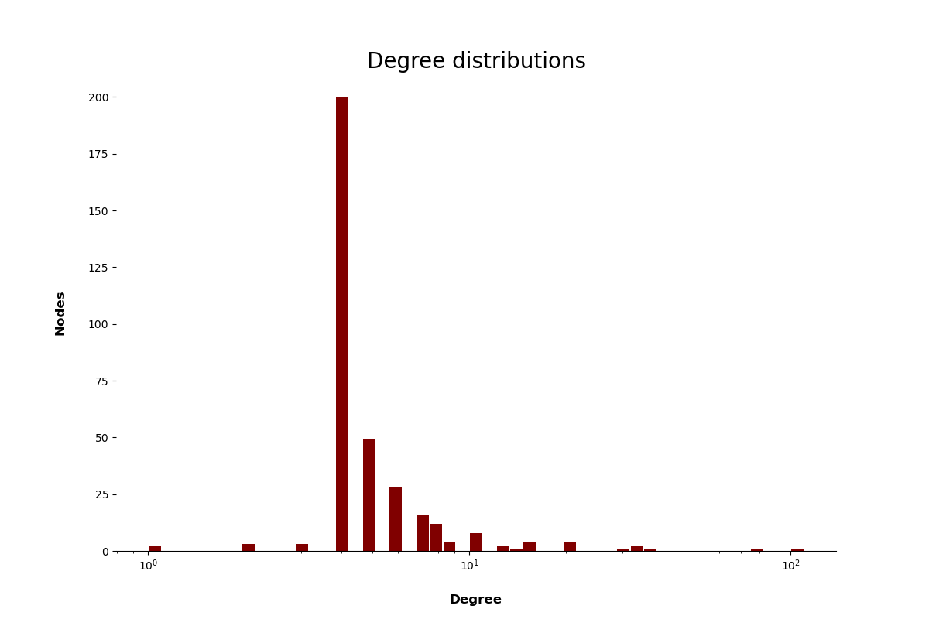
Preliminary data-analysis
The data on retsinformation.dk is structured data contained in the European Legislation Identifier (ELI) standard.
Static data, as revisions to laws will be new laws
We have 343 laws with a total of 2173 unique links
Around 232 MB text data for 2516 rows of node data
Variables:
UID
Text body
Edges
Degree distribution is concentrated around the median of 4 with a few nodes having around 100 edges
This bodes well for finding "high significance" nodes

Slide 6
Tying the methods
Upon establishing significant nodes, based on the network analysis, is it possible by any means to estimate whether a document is significant based on its body of text?
Using neural networks
Possibly by searching for particular paragraph references in the text

